Slide 1
Neighborhood Considerations for Shelter Siting – Focus on Community Impacts
Katy Decker,Veterans Park Neighborhood Association
Hillary Takahashi, Collister Neighborhood Association
Shelter Better Task Force; August 23, 2021
Notes:
Goals - To add criteria for selection

Slide 2
Outline
Residential Buffer: P&Z Boise, Peer City Sites
Shelter Size Perspective
Mapping of Calls For Service data (Ada County Dispatch)
Public Services - is there sufficient capacity?
Outside Assessment of Impacts
Applying the Equity Lens to the Community
Fair Housing
What is Concentration of Poverty?
Trust
Closing

Slide 3
Thank you!
Everyone in this room is dedicated to finding a solution to help those who need a hand up.
Through our readings, we’ve learned that siting a shelter requires commitment and effort by many parties. We are grateful to have been invited to participate in this effort.
We deeply appreciate the dedicated and compassionate work that our speakers to date (and folks in this room) are doing to serve and lift up the underserved populations in Boise.
Notes:
Nothing in this presentation should be construed as a lack of compassion - but we believe we need to identify impacts in order to make this decision responsibly.
Our lens: all citizens of Boise are important whether or not they are experiencing homelessness.

Slide 4
Residential Buffer: Planning and Zoning
• Draft Module 1 of Boise’s Zoning Code Re-write states with regard to a Shelter Home: This use may not be located within 300 feet of a Residential zoning district. (Section 11-03-03-3.D; April 2021)
•What data guided the City to arrive at this number?
•Based on the research done by the City, City Planners and Officials deemed it important to address in the proposed P&Z Module 1
• The City has an opportunity to codify potential Shelter Sites which meet the criteria this Task Force is working toward establishing
• City Siting Criteria may differ than those of IFS due to business model
• Should a need for a buffer zone be ignored simply because of timing ?

Slide 5
Residential Buffer: Additional Considerations
It is our position that any shelter site should have a buffer of non-residential land use surrounding it.
Any given batch of residents simply isn't equipped to be ready to share in the trauma-informed response work required.
We wanted to see what other cities did, so we’ve done a land use analysis for areas surrounding other shelter sites. Following are slides showing the Primary Peer Cities identified in our readings from Week 4 as well as the proposed State St location.
Notes:
-we’ve heard from BPD that this work requires specialized 40-hour crisis response training; BPD/social-worker partner program being rolled out
-and we’ve heard from Andy Scoggins that this is work most of us would have a hard time doing day in and day out.
-Zoning - VPNA/CNA had no input on the zoning code rewrite process (Shelter Home still allowed in new equivalent of C-2 Zone (MX-A and MX-S) as conditional use, but blanket restriction to residential is applied.)
- the City’s own recommendations wouldn’t allow a shelter at this site
-Peer Cities - I note that we are not necessarily endorsing these selections as peer cities; there was

Slide 6
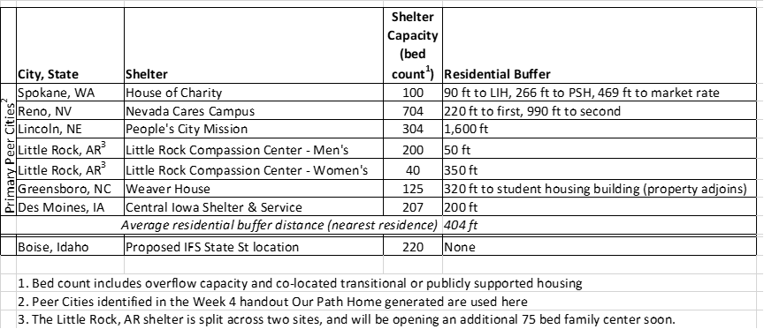
Peer Cities - Residential Buffer
Please see supporting information for maps and statistics regarding these shelters, as well as shelters in additional cities.
V
Notes:
-We’ve presented these sides briefly here, and provided only the primary peer cities identified previously by BSU. Additional map analyses from the secondary list (which we were not able to complete) and other large shelters we previously identified in the West are provided as a handout.
-this table summarizes the estimated buffer distances. Note- shelter bed capacities provided include overflow beds, based on the handout Our Path Home provided. Note we’ve included Interfaith’s proposal as 220 beds per their response to comments on their initial P&Z application.
-While the IFS proposal to site a large shelter adjacent to a residential neighborhood is not unique to operating shelters, it is far more common that cities choose to implement a large buffer between their residential neighborhoods and their emergency shelters. I think we’ve seen that, compared to the primary peer cities, the Interfaith proposal is uniquely embedded in a residential area.
-Among the peer cities, the average residential buffer distance was greater than the current Boise draft code proposal.

Slide 7
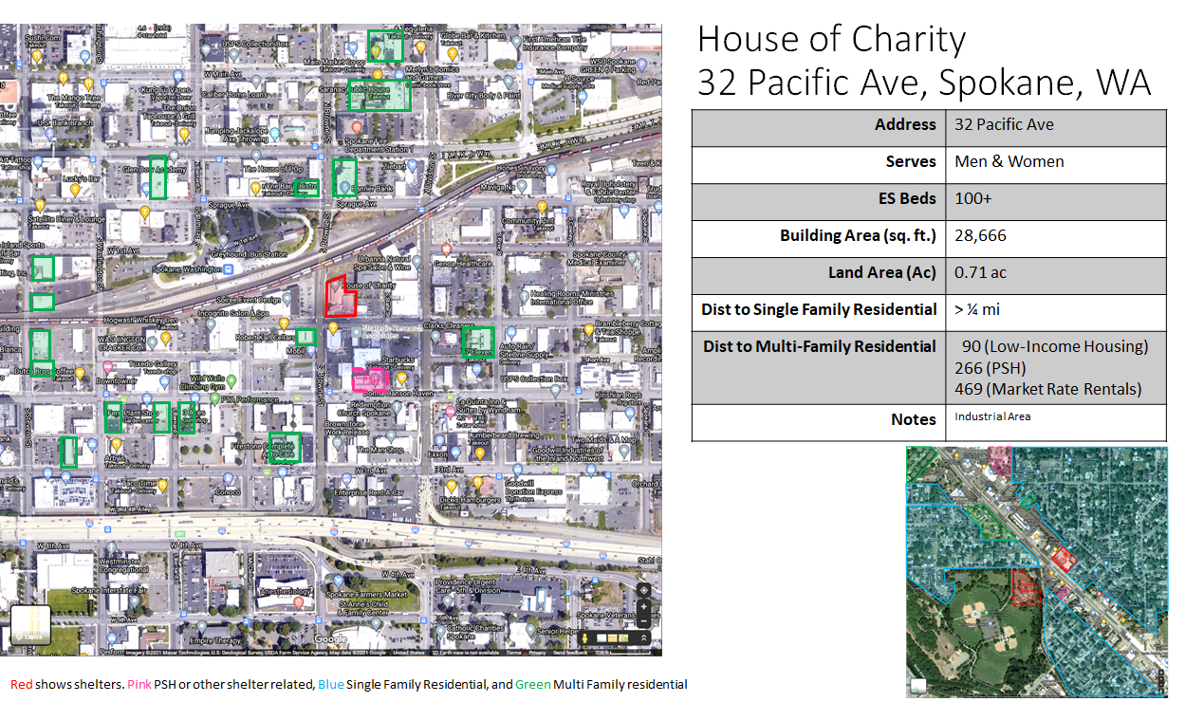
Notes:
-describe how to read slide
-Note abbreviations : LIH = low-income housing; PSH = permanent supportive housing; TH = transitional housing

Slide 8
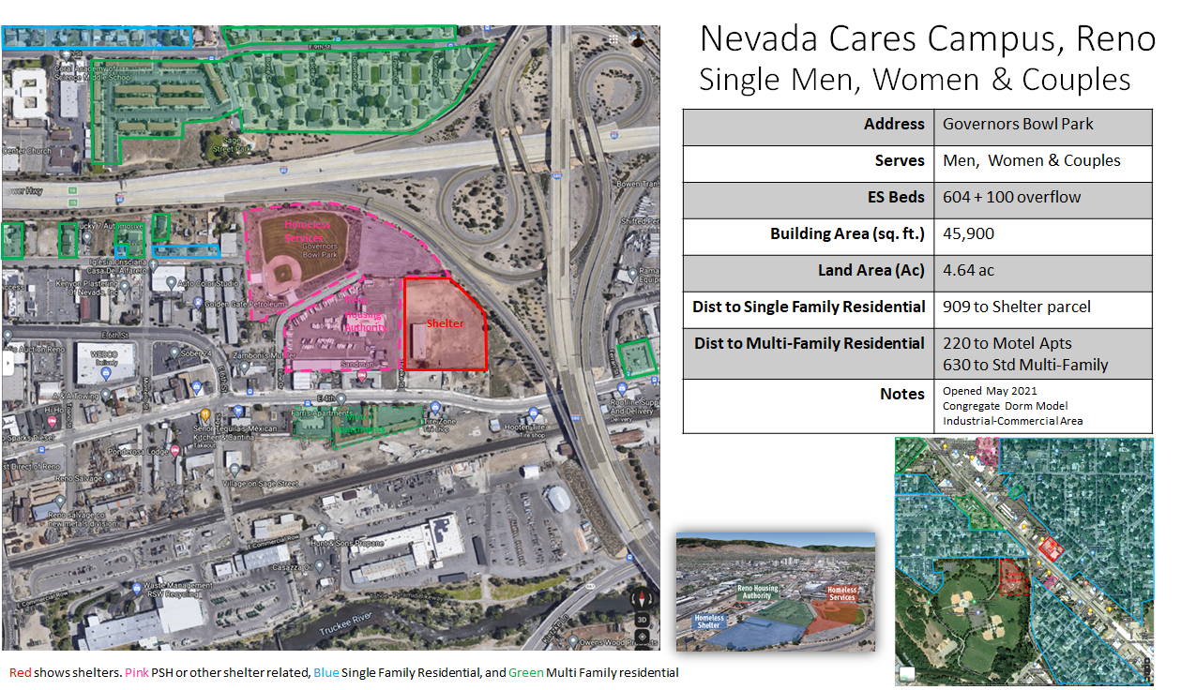
Notes:
-Nevada -
700 capacity… well buffered;
Congregate sleeping
nearest “residential” is a commercial motel advertising with weekly and monthly rates, so we’ve categorized it as potential housing
-c

Slide 9
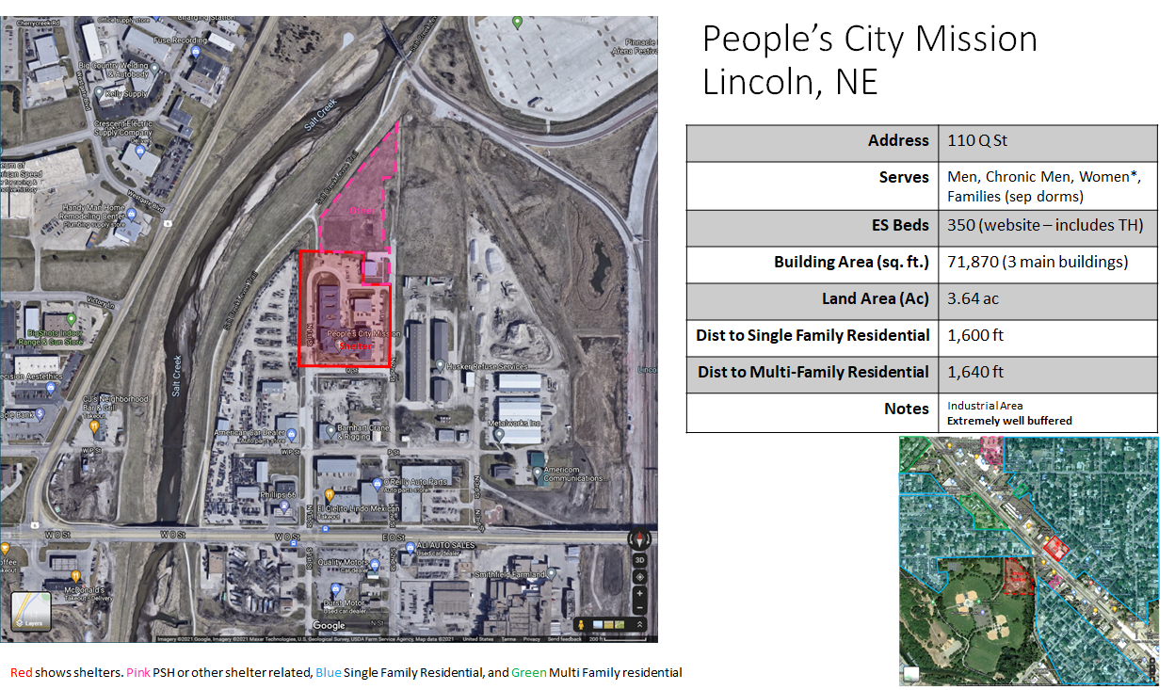

Slide 10
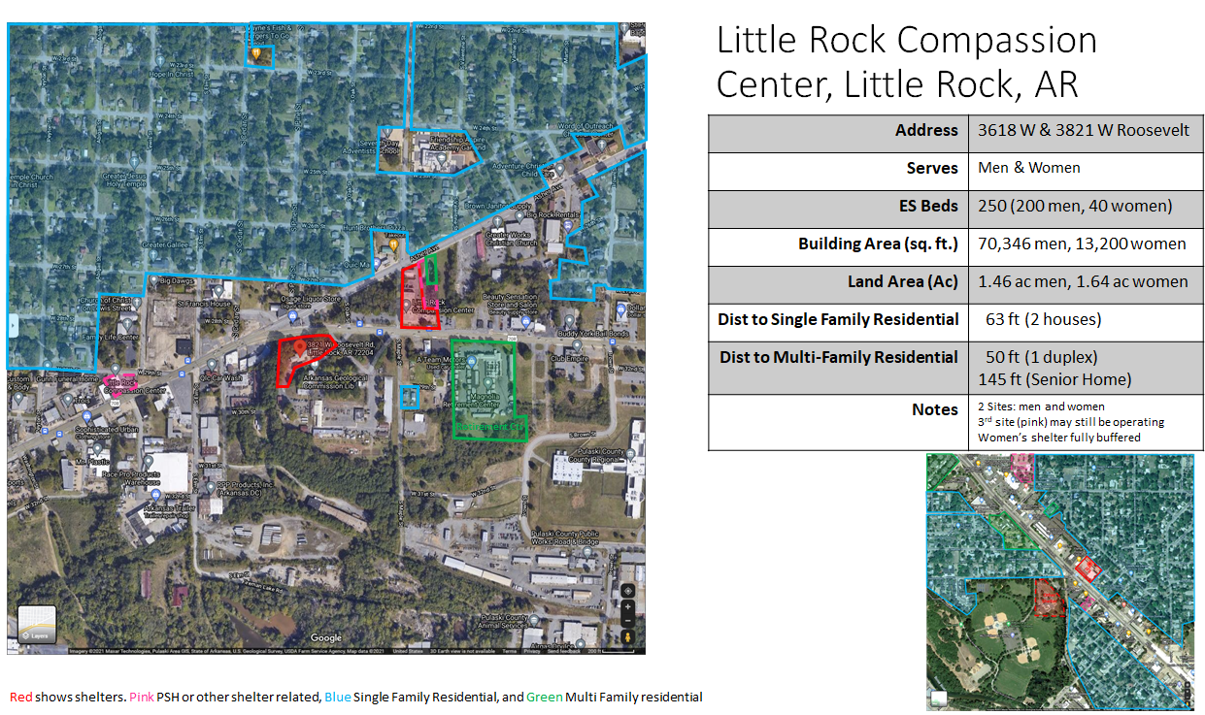
Notes:
-Little Rock - data provided was for two sites
-This data is slightly differing than what was offered by TaskForce

Slide 11
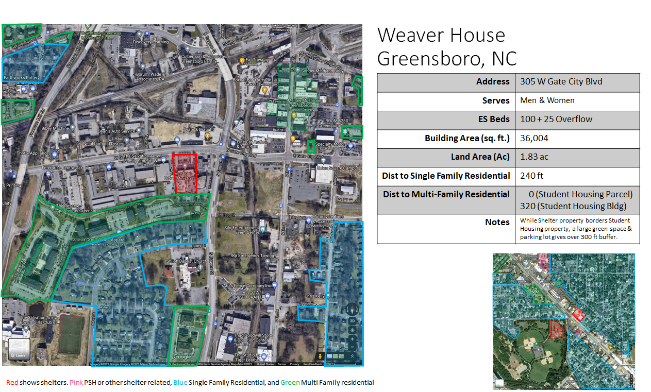
Notes:
-Greensboro - adjoining MF residential property’s parking and entrance, but note that over 300 ft to residential building

Slide 13
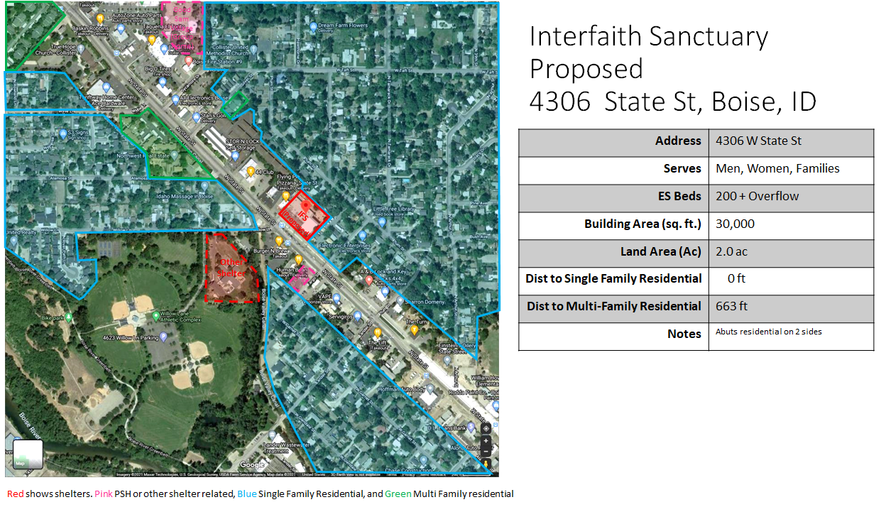
Notes:
State St
- we’ve included an additional potential PSH site;
- this week’s homework mentioned not siting shelters near one another
- amenities serve to draw folks through neighborhood (greenbelt access/willow park)

Slide 14
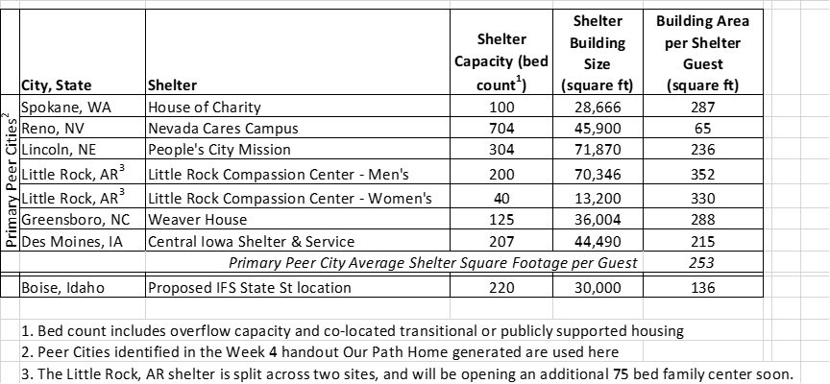
Shelter Size Perspective
Please see supporting information for maps and statistics regarding these shelters, as well as shelters in additional cities.
Notes:
Katy :
-despite the 24-hr availability, based on 1) cramped conditions and 2) in-shelter restrictions (e.g., no alcohol or drugs allowed on-site, lack of privacy to have sex), we do anticipate that people will choose to seek more space and presumption of privacy outside of the shelter (for both activities that would be legal and unjudged in private and potential illegal substance use for those still struggling with substance abuse disabilites (this general comment is supported by comments from Salt Lake County homeless services representative who agreed to speak with us - who recently opened a new shelter;note - their shelter is a similar 24 hr service model and offers twice the space per person as the proposal)
-the shelter is anticipated to serve a population with a high degree of individual trauma experiences in their residents
Share anecdote about D&A living with us to prep for roll into shelter space per guest
Include quote? (re: shelter can be a barrier?) “Most shelters tend to attract people who are chronically homeless and addicted. This can be frightening to someone newly homeless or to those who struggle with mental illness or social phobias” [Arlington Shelter, 2020

Slide 15
Mapping of Calls for Service (CFS) Data
Why are so many cities avoiding residential neighborhoods?
Is the crime and safety concern frequently expressed reasonable?
To find out, we requested Ada County Dispatch Data for the area near Interfaith’s existing 1620 River St shelter, and the proposed 4306 State St Location (January 2018 - February 2021)
Methodology: Removed duplicate incident numbers
Removed assist calls
Grouped call codes into general categories
Omitted Welfare Checks, Traffic Stops, and Vehicle only Collisions from detail maps
Please see supporting information for the full set of categorized calls to service maps.
V
Notes:
hill

Slide 16
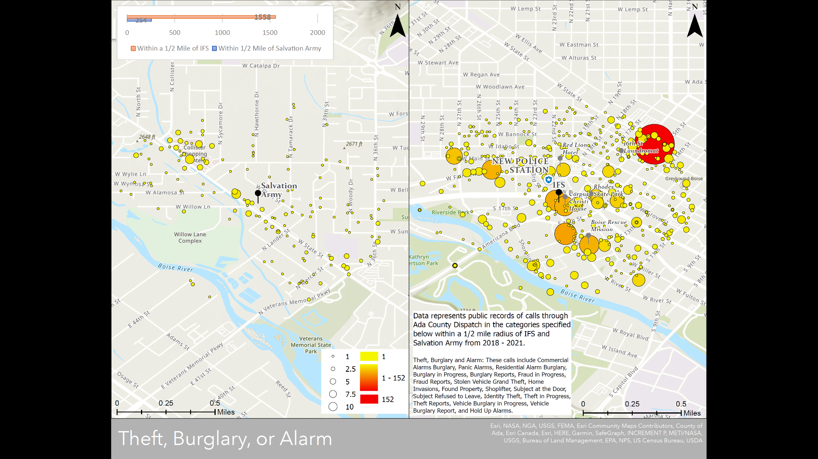
Notes:
Describe how to read maps
Rite Aid represents the large red circle area

Slide 17
Notes:
Up to 10% of those shelter avoidant state the drug culture as the reason
We also heard from neighbors who were formerly experiencing homelessness that the drug culture surrounding shelter was something they were glad to be away from and concerned about it being brought into the neighborhood with the state street shelter site
IFS does not allow drug and alcohol use so the majority of those behaviors are pushed off site

Slide 18
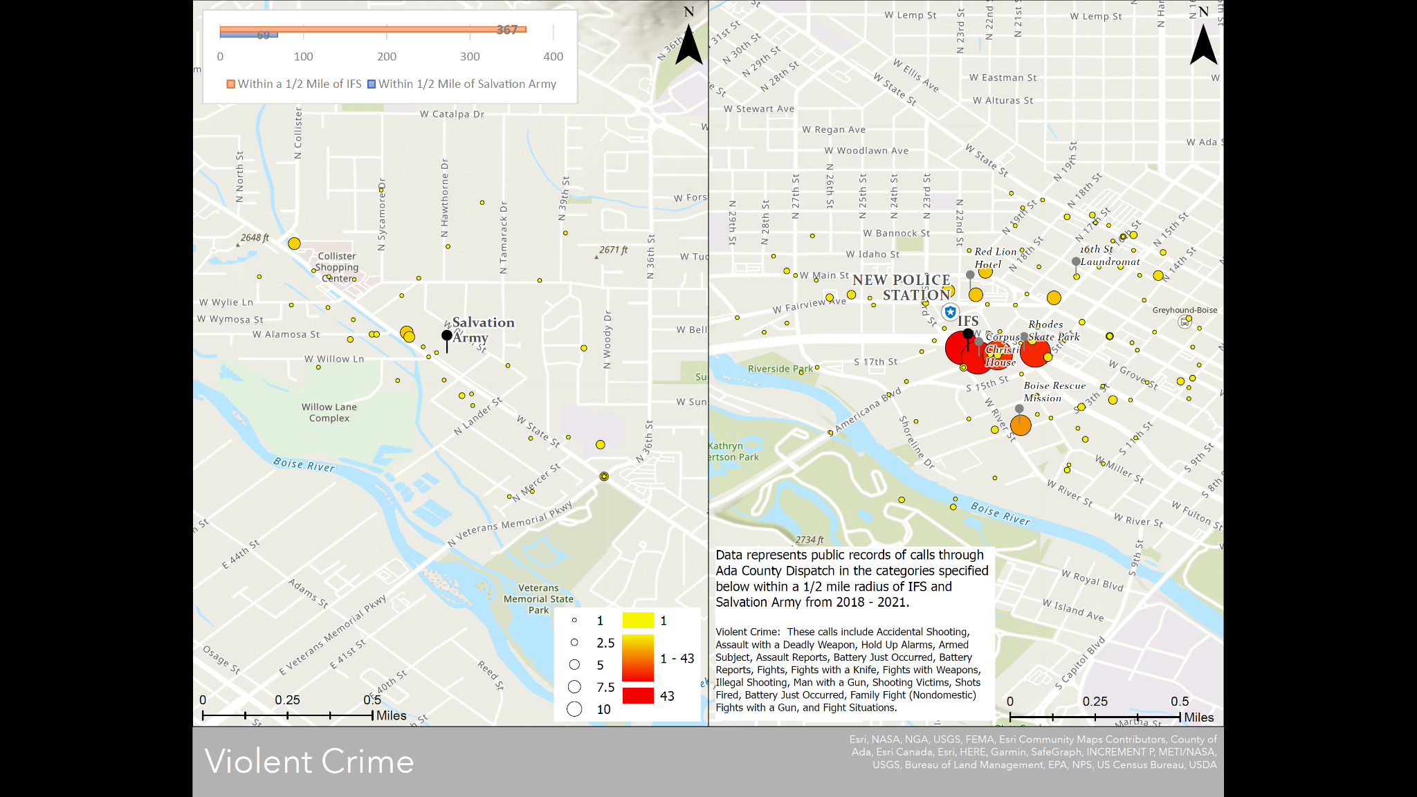

Slide 19
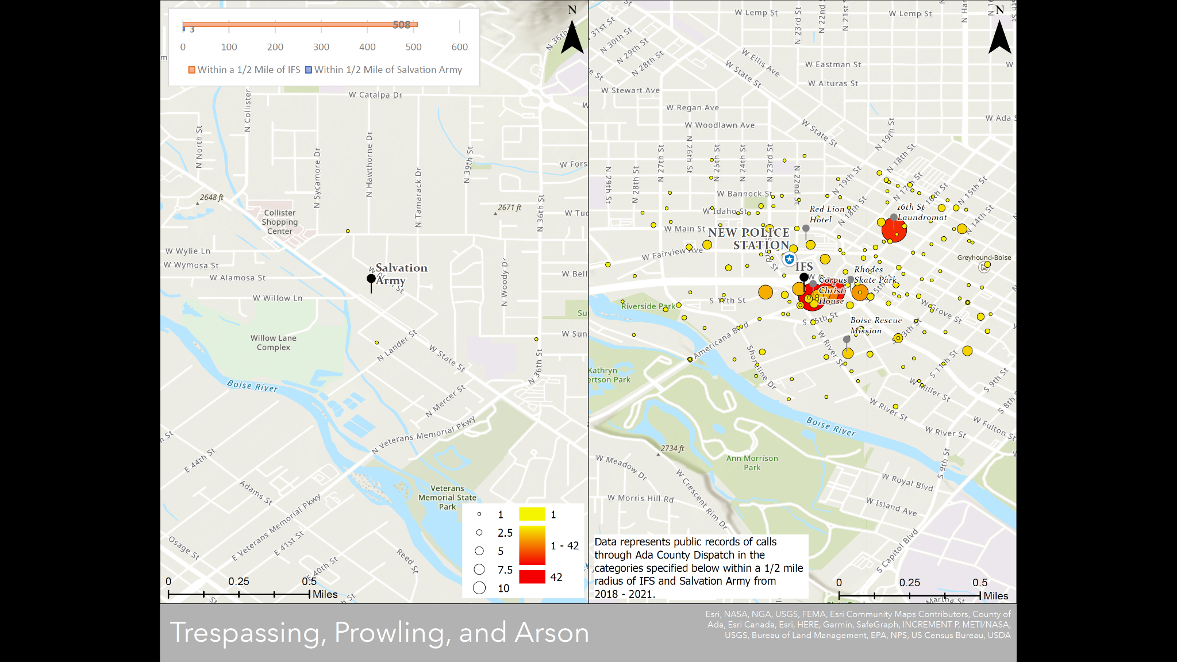
Notes:
-mention trespass list (60+ addresses with trespass letters within 0.4 miles of 1620 River St)

Slide 20
Crime Prevention Through Environmental Design (CPTED) - Police CFS
Providing complimentary data from BPD as a trusted source
Shown here - top 10 call types within Shoreline District, with number of calls per year
“The high calls unique to the assessment area are trespassing, illegal camping, liquor violation, illegal parking, and check for sleeper.”
Shoreline Urban Renewal District CPTED Assessment, performed by Boise Police Department on October 15, 2020
Notes:
Katy
-of course, you should always consider your source - we mapped this data ourselves. We later learned that BPD had conducted a similar effort in October 2020, though less granularized
-CPTED has been provided as supporting documentation. (It also address concerns of the business community.)

Slide 21
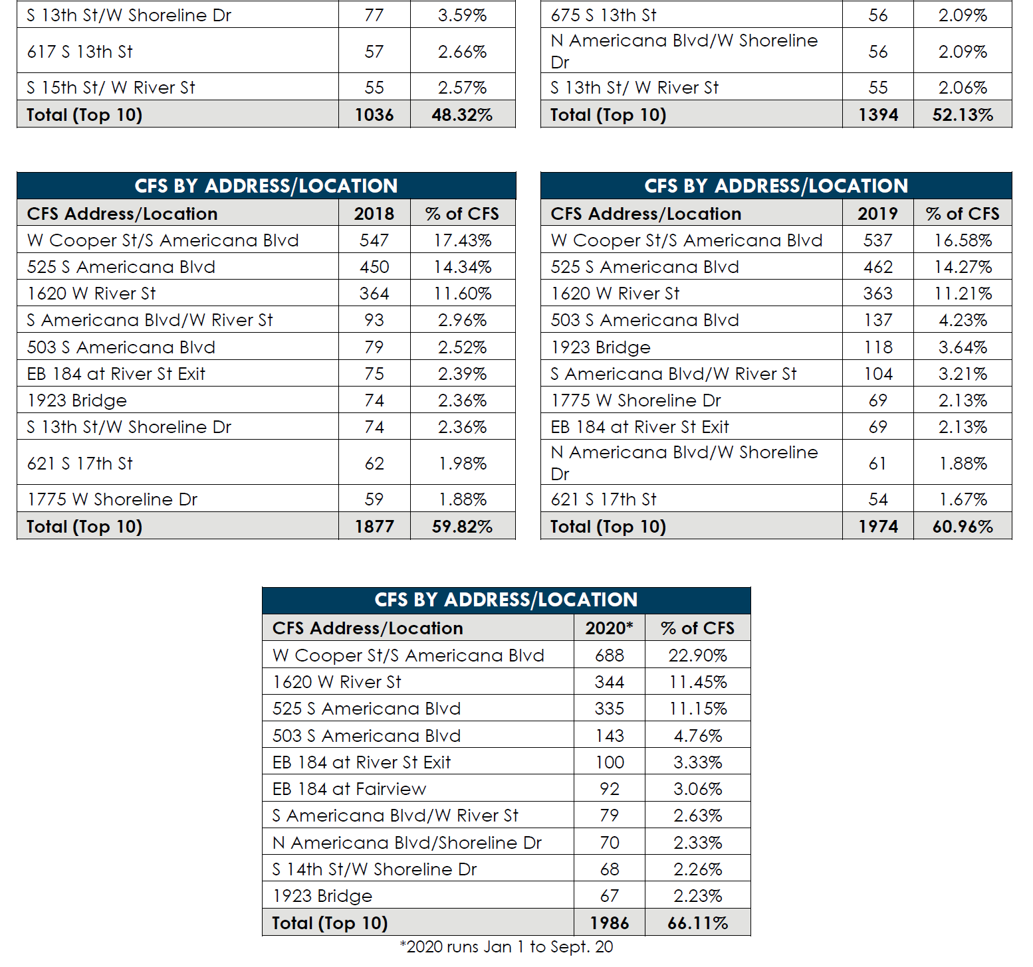
Crime Prevention Through Environmental Design (CPTED) - Police CFS
These charts show top repeat call locations within the assessment area.
“Interfaith Sanctuary and Corpus Christi are consistently in the (top) ten addresses for CFS in Boise each year.”
Typically receive ~1 call/day
Notes:
katy

Slide 22
Reflections on Emergency Calls for Service
We understand City of Boise has allocated budget to reopen the Willow Lane substation.
Police call for service is a reactive response to a problem; we would prefer proactive solutions to prevent, rather than respond to, incidents.
Could additional emergency response presence create its own community problems
Noise Pollution
Increased Emergency Traffic
Notes:
-Note: wrapping up police calls - we’ve already heard from BPD that they expect to reallocate units to follow the shelter if it moves away from current service area, and we’ve seen that City of Boise has allocated budget to re-open the Willow Lane substation (abandoned for poor function a few years ago when new station was built to better serve IFS)
-A Police response is a re-active response to a problem; we would prefer pro-active solutions to prevent, rather than respond to, incidents.
-It is worth noting, in light of the national conversation we’ve been having for the past few years, that increased police presence may itself be considered an impact in some communities. Will this be a trauma trigger for some minority communities?

Slide 23
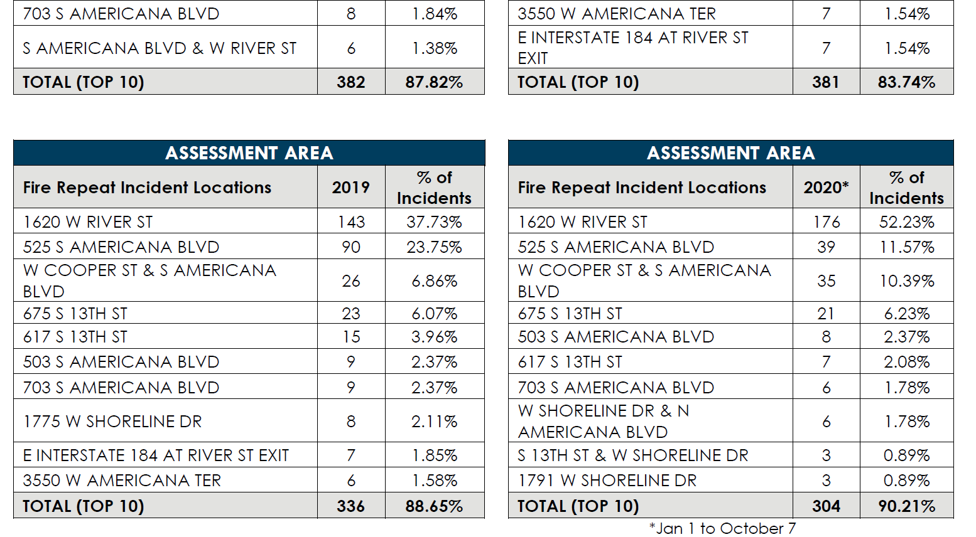
Crime Prevention Through Environmental Design (CPTED) - Fire/EMS CFS
These charts show top repeat Fire/EMS call locations within the assessment area.
Interfaith Sanctuary had the highest repeat calls each year (143 - 176 per year, 2017 - 2020)
This equates to around 3 calls per week.
By contrast, the State St location averaged 4 calls per year.
-

Slide 24
Pubic Services - is there enough capacity?
Fire/EMS
Fire Station 9 hosts one crew; no built in redundancy
Station 9 does not meet 240 second response time criteria throughout service area
No EMS crew within 240 second response time criteria
Library
7,955 sq ft facility with 16 computer stations; high utilization
Schools
The McKinney-Vento Act provides homeless students the right to continue attending the school or origin or enroll in any public school that nonhomeless students who live in the same attendance area are eligible to attend, according to the student's best interest.
BPD expects to reallocate resources to follow Interfaith, if outside the existing downtown station service area.
How does that interact with the department having insufficient staffing? (40-50 officers low)
Notes:
Hill
-share statistics for fire/EMS calls - leads to noise/siren impact on surrounding community as well as to broader public health question (no EMS within response time to State St; fire house has only one crew (no redundancy), already unable to meet response time within their district; high call facility will exacerbate potential delays) (//perhaps this should be moved to part 2, but I think there would be similar issues with lack of redundancy at other sites outside of the downtown core)
-Boise Police Department has already been reporting chronic understaffing for several years based on an officer:population ratio of 1.28 officers:1,000 residents. In September of 2020, the Boise Police Chief reported that they needed to hire an additional 40 to 50 officers to be staffed at levels comparable to other well ordered mid-sized cities. The Police Chief also reported that when cities hit a population threshold between 300,000 to 400,000, which Boise is quickly approaching, crime begins to increase exponentially. In short, the Boise Police Department is chronically understaffed, is trying to prepare for an exponential increase in crime as the population grows, and has recently invested significant resources to open a substation near Interfaith Sanctuary’s existing downtown shelters.

Slide 25
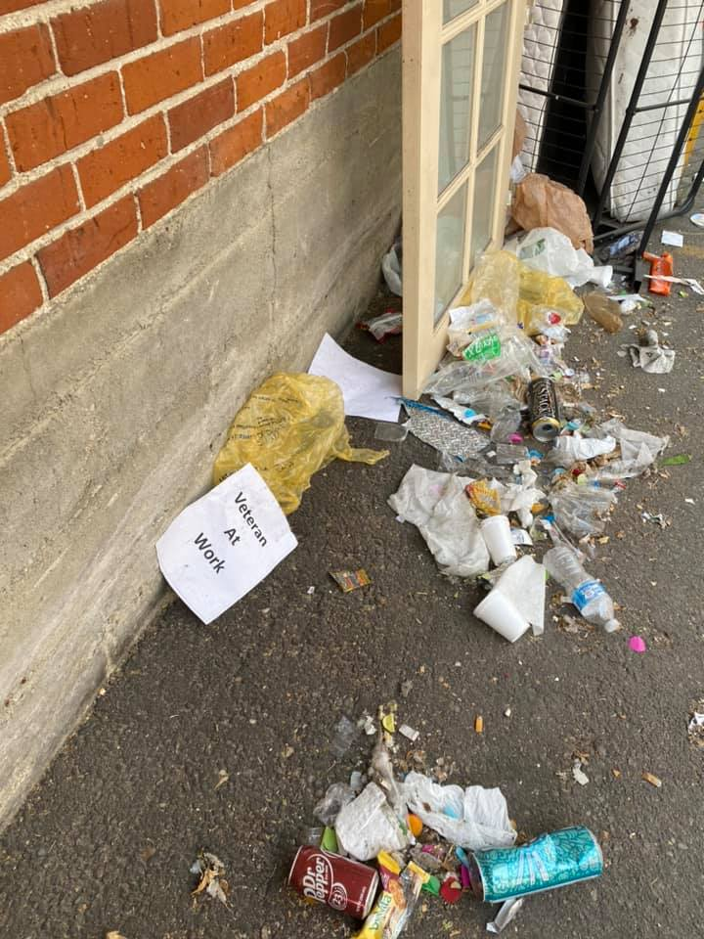
Bias Concerns
Littering: Cooper Court, weekly clean-up required
Violent Crime: Timmy Kinner, Allen Scott Hernandez
“There are some guests that are violent being dropped off by the police to the center. There was an incident last week, where someone returned to Alpha Munitions and threatened staff with a knife. The individual was not arrested. Bob regularly collects paraphernalia and weapons from around his property, as people are often leaving their weapons in spaces outside of the HRC or have weapons on their person in spaces that aren’t covered by total body searches”
[6 mo SLC Shelter Report]
Missoula, Montana, “the Pov” - Adjacent to Residential Neighborhood, cited as a successful example in this week’s readings:
However, no amount of good intentions or quality outreach can mitigate all of the adverse impacts that flow from the Pov.
We wish, as an established neighborhood, that we would have come together when the City decided to move the shelter to our neighborhood, and fought to move it to a more suitable location.” [Westside Neighborhood Association, Missoula, MT, 2018]
Cooper Court,
Wednesday, 8/18/2021
Notes:
Hill
Unless we look at the good and the bad aspects we cannot clearly identify solutions
Look at impacts with open eyes, for instance Cooper
Unless we look at the good and the bad aspects we cannot clearly identify solutions
-reference Timmy Kinner and Allen Scott Hernandez?
- Timmy Kinner, IFS Guest, although he was not a guest at the time of attack

Slide 26
Outside Assessment of Impacts
Effect of Emergency Homeless Winter Shelters on Property Crime; Faraji, Ridgeway, and Wu; January 11, 2018
Significant increase in crime in residential areas surrounding emergency shelters, particularly property crime.
Within 100 meters (m) (333 ft) the study showed a 56.3% increase in property crime, and as far out as 400 m (1,312 ft) the increase is still significant at about 9%.
For a commercial area, the observed effect was the opposite, with rates of breaking and entering 34% lower after the opening of an emergency shelter,
may have been explained by businesses increasing security when an emergency shelter was installed
Or, through providing shelter, unsheltered homeless individuals who were already in the area of the shelters were less motivated to seek shelter in empty businesses at night.
Close to Home: Does Proximity to a Homeless Shelter Affect Residential Property Values in Manhattan, Independent Budget Office of the City of New York, September 2019
Decrease in residential values of 7.1% for properties within 500 ft
Decrease of 17.4% for properties within 1000 ft of two or more emergency shelters;
Effect is additive - residence within 500 ft of one emergency shelter and within 1000 ft of a second, the anticipated impact on property value is a decrease of 24.5%.
Note: 82.3% of the properties were condominiums in elevator buildings. Since these properties are insulated from street-level impacts of homelessness and property crime impacts, it is reasonable to speculate that a higher impact may be observed in Boise’s environment, where most properties are at street level.
Notes:
Katy
Academic literature is limited with regard to studies on the effects of emergency shelter on the surrounding community. We did identify many studies on Transitional Housing and on Permanent Supportive Housing,which typically find low to no impact, but very few on Emergency Shelter. We note that these emergency shelters are not the same 24 hr operation +programs that Interfaith proposes.
Property value - is in VPNA neighborhood plan, incorporated into Blueprint Boise

Slide 27
Applying the Equity Lens to the Community
We have established there will be SOME impact to the surrounding area
If the shelter is sited on State St, ANY impact will be disproportionately borne by the pre-existing low-income, high-poverty, and minority communities adjoining the site.
In light of national conversation, we should consider whether increased police presence could, itself, be an impact or trauma trigger to some marginalized communities.
Willow Lane
Plum Street
Riley Court
Notes:
Katy & Hill
Based on comments from the police department and review of Fire/EMS service need projections, I think we can agree that there IS an impact.
-In Mia Bryant's presentation we heard about the importance of considering equity in offering services.
We need to expand that consideration and note that ANY impact a prospective shelter in this location may create will be disproportionately born by a low income and minority population present in this area.
Some of these residents have lived experience of homelessness themselves, and many are housing insecure (e.g., living 'doubled up,' being asked to leave rentals, etc.) This is our over-arching concern with the location.

Slide 28
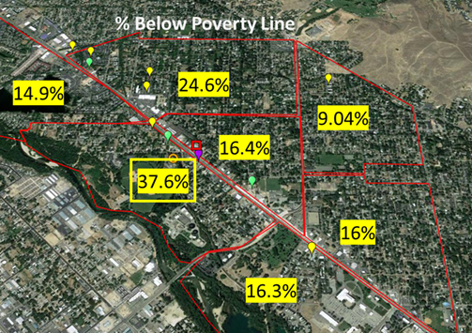
Veterans Park Neighborhood Community Demographics
VPN aggregate poverty level 28.7%
Closest part of Collister - 24.6%
City of Boise - 13.7%
VPN >50% of households are low-income (80% AMI or below)
VPN -
47% owner-occupied
42.7% cost burdened
46% renter-occupied
21.8% cost burdened
VPN - 23% minority population
City of Boise - 17.6%
Interfaith, range ~6% to ~30%, PIT data typically 20%-25%
Collister
VPN
Sunset
-All Neighborhood Data presented here is pre-COVID: 2019 Census Data; Boise City Idaho Analysis of Impediments to Fair Housing Choice, 2016, Map 3; City of Boise Community Development Analysis 2020; City of Boise Neighborhood Data Almanac, March 2020
Notes:
Katy
-In Boise as a whole, 13.7% of residents are below the poverty line
-You can also see that in the Sunset, here to the right, aggregate poverty level is below 15%
-As others have noted, there are a mix of income levels in our neighborhood… I mean, the Boise Boys just sold a house for $1.5 million. But that is not representative of the homes closest to the proposed site.
-State St URD = has been designated a blighted area
-minority population - VPNA is 8th most diverse of 36 neighborhood associations in Boise

Slide 29
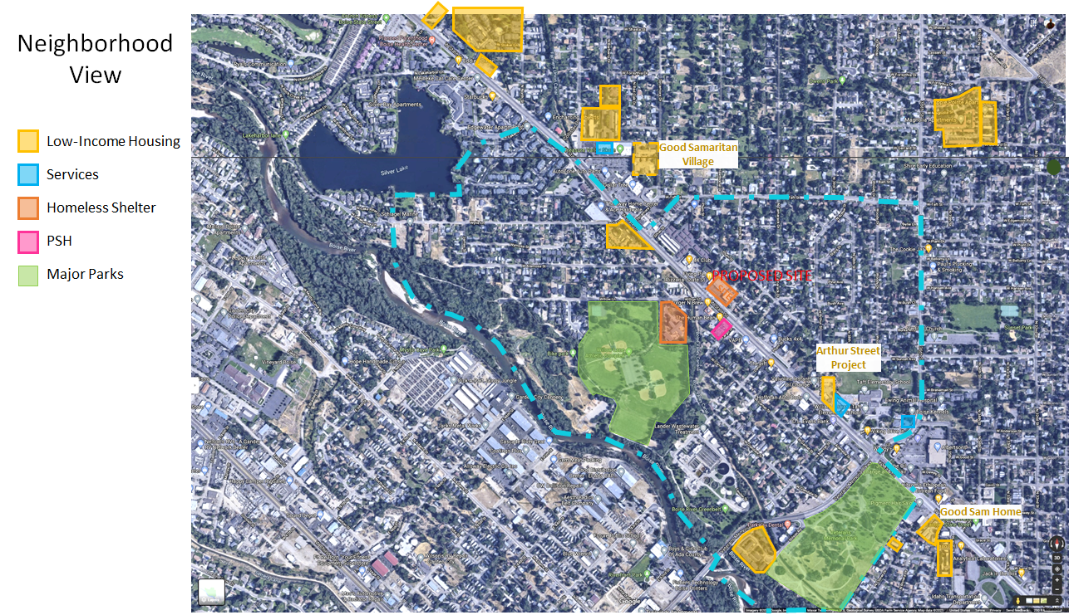
Notes:
Katy
Expanding out to a neighborhood view, we can see another type of visual to convey the relative wealth of the neighborhood.
-again, VPN is outlined in blue
-sites with designated low-income housing units are shown in yellow.
----I do want to note, that Veterans Park Neighborhood has expressed support for low income housing developments before P&Z, when a developer was proposing to build what he described as a “low budget motel” at Alamosa, across the street from the strip club.
----Showing the locations of low income housing should not be construed as opposition to such, but we DO want to point out the relatively high concentration already in play here; I’d also like to note that we really value our refugee community, and Wylie Street Station is specifically designated as refugee housing
----I also want to note, this is in addition to our “naturally affordable” housing stock - the Community Needs Assessment puts the median rent in our tract as $958
----we’ve included the Arthur Street project, which VPNA is currently participating in the design selection for
----
----I also want to point out that we understand that Good Samaratin Home, which provides very low income housing, and is sometimes considered supportive housing, as meals are also provided, is currently working with the City of Boise to look at expansion plans which would increase the capacity of their existing State St site from 45 to ~150 units as well as convert the Good Samaratin Village, recently a retirement home, near the Collister Center to additional affordable or supportive housing.
-the immediate vicinity of the proposed site also includes another shelter providing emergency shelter and transitional housing, and Valor Pointe, a permanent supportive housing facility.
-blue are showing community services - we have the Library, St. Mary’s food bank, and Taft Elementary shown here.
-It is not feasible to reduce the privacy of the Class A wetlands or well-screened riparian corridor along the greenbelt

Slide 30
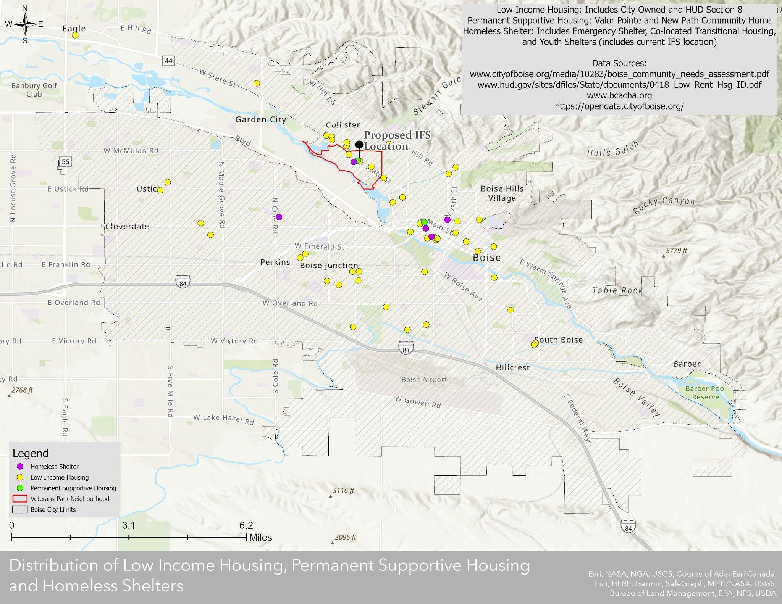
Notes:
Zooming out again, we take a bigger look at where shelter, low-income housing, and permanent supportive housing are located within Boise’s 84 square mile area.
We see that the State St Corridor through Veteran’s Park and to a thousand feet or so from each boundary has a lot of housing diversity; there is another cluster near downtown Boise, and otherwise there is a small emergency shelter for unaccompanied youth and scattered low-income housing.
There is a lot of Boise that doesnt’ have any low-income housing.
Again, I’m very supportive of low-income housing, but I think we should be wary of continuing to cluster our construction of diverse housing options. We have another housing development coming in soon along State Street, and I’ve just learned that the City has asked the developer to include 20% of units as low-income housing - this is the type of development strategy love - creating mixed income communities, rather than specific low-income communities, and would love to see applied broadly throughout Boise, though I would think we’d need a somewhat higher percent of affordable units designated in each development.
-note (to include????): other shelter CUPs include requirements to not re-house people within 1/2 mile of the shelter - this allows people to remove themselves from the environment in which they experienced homelessness and avoids segregation of low income or disabled populations within the area near the shelter. In the case of this prospective location, a similar condition would put a large portion of the city's publicly supported housing options out of reach to shelter guests.

Slide 31
What is Fair Housing?
The Fair Housing Act, Title VIII of the Civil Rights Act of 1968, has two main goals:
Prevent housing discrimination for protected classes:
race, color, religion, sex, disability, familial status, or national origin
Disability includes physical or mental disability as well as untreated chemical dependency
Discrimination includes segregation of people in protected classes.
Fair Housing Choice
People of all income levels should have a choice in which neighborhood they choose to live in.
Development of fair-share housing approach in distribution of diverse housing options
Fair Housing Act criteria are incorporated into Blueprint Boise in Goals NAC8 and NAC9.
Re-segregation of protected classes or over-concentration of low-income and very-low income housing options could be construed as Fair Housing Violations.
Notes:
Katy

Slide 32
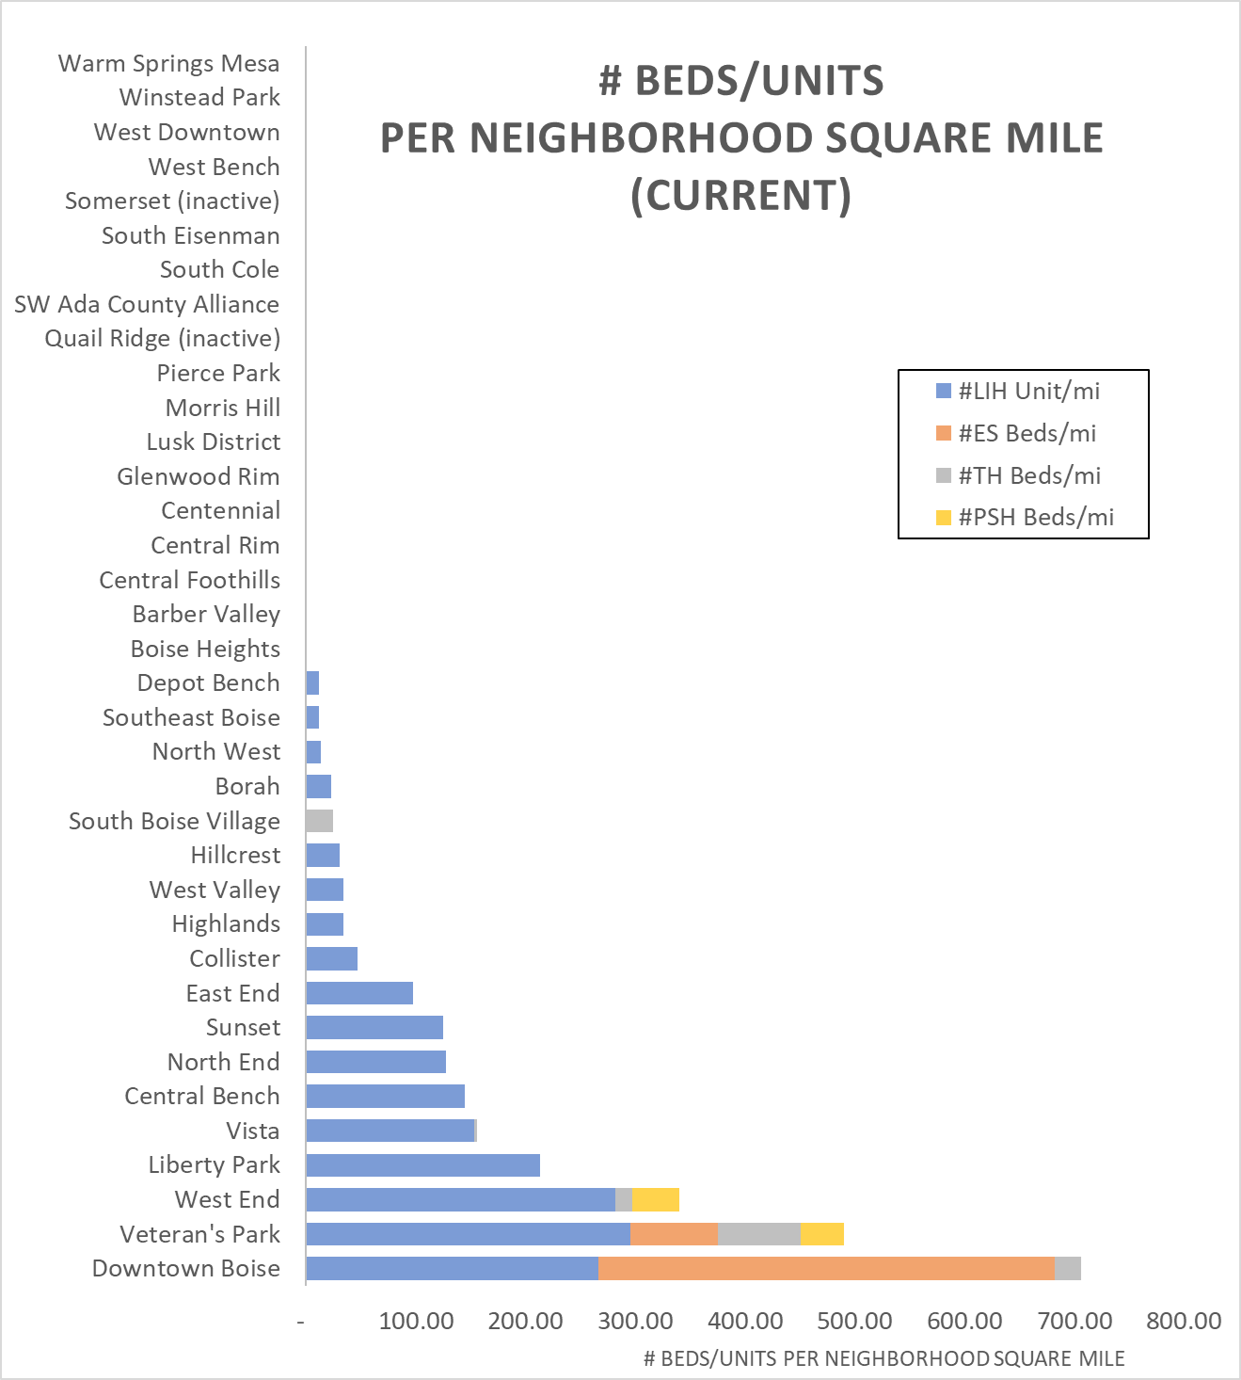
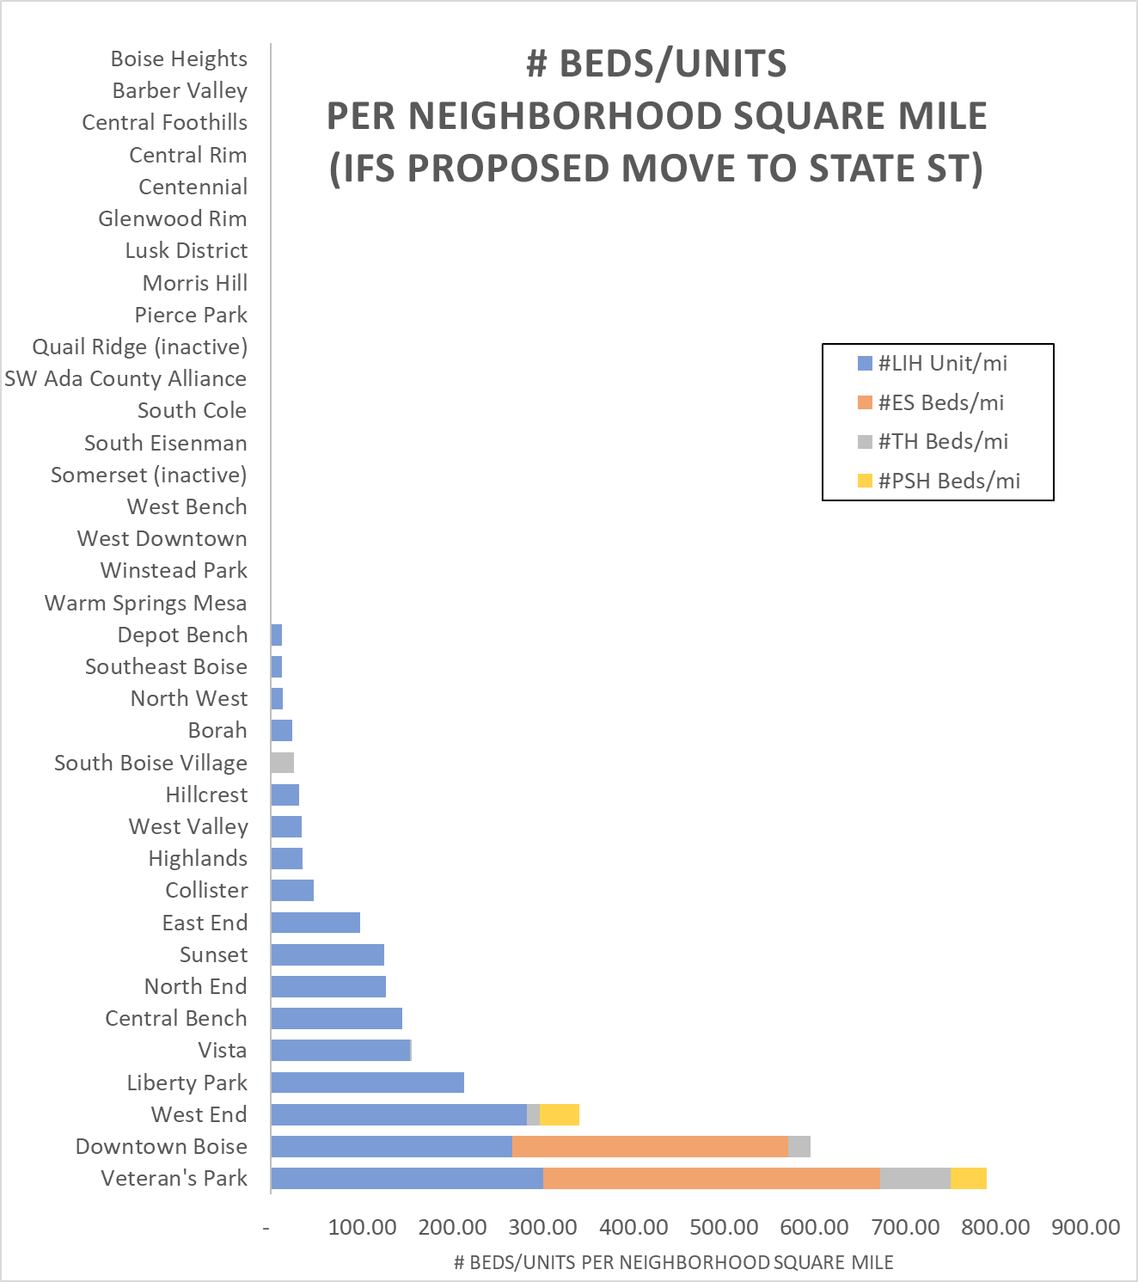
*includes Arthur St assumption at 75 units LIH
In the existing condition, VPN has the 2nd highest number of diverse housing and/or shelter options per mile of any neighborhood in the city
If the proposed shelter were to be sited on State Street, the density of housing options would exceed Downtown Boise’s (and be greater than downtown’s current density per square mile)
Notes:
Another view of our city’s housing distribution is shown here - as you can see, Veteran’s Park is already supporting a larger amount of housing diversity than anywhere but the Downtown area. Transfer of another large shelter to this area would bring ug to XXXXXXXXXXXX

Slide 33
What is Concentration of Poverty
...review of the U.S. literature...suggests that the independent impacts of neighborhood poverty rates in encouraging negative outcomes for individuals like crime, school leaving, and duration of poverty spells appear to be nil unless the neighborhood exceeds about 20 percent poverty, whereupon the externality effects grow rapidly until the neighborhood reaches approximately 40 percent poverty; subsequent increases in the poverty population appear to have no marginal external effect. Analogously, the independent impacts of neighborhood poverty rates in discouraging positive behaviors like working appear to be nil unless the neighborhood exceeds about 15 percent poverty, whereupon the effects grow rapidly until the neighborhood reaches roughly 30 percent poverty; subsequent increases in poverty appear to have no marginal effect.
-Galster, 2010, The Mechanism(s) of Neighborhood Effects: Theory, Evidence, and Policy Implications
Notes:
Hill
Social-Interactive Mechanisms This set of mechanisms refers to social processes endogenous to neighborhoods. These processes include:
• Social Contagion: Behaviors, aspirations, and attitudes may be changed by contact with peers who are neighbors. Under certain conditions these changes can take on contagion dynamics that are akin to “epidemics.”
• Collective Socialization: Individuals may be encouraged to conform to local social norms conveyed by neighborhood role models and other social pressures. This socialization effect is characterized by a minimum threshold or critical mass being achieved before a norm can produce noticeable consequences for others in the neighborhood.
• Social Networks: Individuals may be influenced by the interpersonal communication of information and resources of various kinds transmitted through neighbors. These networks can involve either “strong ties” and/or “weak ties.”
• Social cohesion and control: The degree of neighborhood social disorder and its converse, “collective efficacy” (Sampson, Morenoff, and Earls, 1999), may influence a variety of behaviors and psychological reactions of residents.
• Competition: Under the premise that certain local resources are limited and not pure public goods, this mechanism posits that groups within the neighborhood will compete for these resources amongst themselves. Because the outcome is a zero-sum game, residents’ access to these resources (and their resulting opportunities) may be influenced by the ultimate success of their group in “winning” this competition.
• Relative Deprivation: This mechanism suggests that residents who have achieved some socioeconomic success will be a source of disamenities for their less-well off neighbors. The latter, it is argued, will view the successful with envy and/or will make them perceive their own relative inferiority as a source of dissatisfaction.
• Parental Mediation: The neighborhood may affect (through any of the mechanisms listed under all categories here) parents’ physical and mental health, stress, coping skills, sense of efficacy, behaviors, and material resources. All of these, in turn, may affect the home environment in which children are raised.
Environmental Mechanisms Environmental mechanisms refer to natural and human-made attributes of the local space that may affect directly the mental and/or physical health of residents without affecting their behaviors. As in the case of social-interactive mechanism, the environmental category can also assume distinct forms:
• Exposure to Violence: If people sense that their property or person is in danger they may suffer psychological and physical responses that may impair their functioning or sensed well-being. These consequences are likely to be even more pronounced if the person has been victimized.
• Physical Surroundings: Decayed physical conditions of the built environment (e.g., deteriorated structures and public infrastructure, litter, graffiti) may impart psychological effects on residents,such as a sense of powerlessness. Noise may create stress and inhibit decision-making through a process of “environmental overload” (Bell et al., 1996).
• Toxic Exposure: People may be exposed to unhealthy levels of air-, soil-, and/or water-borne pollutants because of the current and historical land uses and other ecological conditions in the neighborhood.
Geographical Mechanisms Geographic mechanisms refer to aspects of spaces that may affect residents’ life courses yet do not arise within the neighborhood but rather purely because of the neighborhood’s location relative to larger-scale political and economic forces such as:
• Spatial Mismatch: Certain neighborhoods may have little accessibility (in either spatial proximity or as mediated by transportation networks) to job opportunities appropriate to the skills of their residents, thereby restricting their employment opportunities.
• Public Services: Some neighborhoods may be located within local political jurisdictions that offer inferior public services and facilities because of their limited tax base resources, incompetence, corruption, or other operational challenges. These, in turn, may adversely affect the personal development and educational opportunities of residents.
Institutional Mechanisms The last category of mechanisms involves actions by those typically not residing in the given neighborhood who control important institutional resources located there and/or points of interface between neighborhood residents and vital markets:
• Stigmatization: Neighborhoods may be stigmatized on the basis of public stereotypes held by powerful institutional or private actors about its current residents. In other cases this may occur regardless of the neighborhood’s current population because of its history, environmental or topographical disamenities, style, scale and type of dwellings, or condition of their commercial districts and public spaces. Such stigma may reduce the opportunities and perceptions of residents of stigmatized areas in a variety of ways, such as job opportunities and self-esteem.
• Local Institutional Resources: Some neighborhoods may have access to few and/or high-quality private, non-profit, or public institutions and organizations, such as benevolent charities, day care facilities, schools, and medical clinics. The lack of same may adversely affect the personal development opportunities of residents.
• Local Market Actors: There may be substantial spatial variations in the prevalence of certain private market actors that may encourage or discourage certain behaviors by neighborhood residents, such as liquor stores, fresh food markets, fast food restaurants, and illegal drug markets.
Gensler, 2002
Compared with otherwise identical children
raised by otherwise identical parents in a neighbourhood with a low average
poverty rate of five (5) percent, children experiencing an average 40 percent
rate are predicted through their simulation with estimated parameters to have
a: (1) 24 percentage-point greater chance of having a child before age 18;
(2) 14 percentage-point lower probability of graduating from high school;
(3) 10 percentage-point lower probability of graduating from college; and
(4) $13,334 lower annual earnings, all else equal

Slide 34
Causal Pathways for Impacts of Concentration of Poverty
Social-Interactive Mechanisms
Social Contagion
Collective Socialization
Social Networks
Social cohesion and control
Competition
Relative Deprivation
Parental Mediation
Environmental Mechanisms
Exposure to Violence
Physical Surroundings
Toxic Exposure
Geographical Mechanisms
Spatial Mismatch
Public Services
Institutional Mechanisms
Stigmatization
Local Institutional Resources
Local Market Actors
-Galster, 2010, The Mechanism(s) of Neighborhood Effects: Theory, Evidence, and Policy Implications
Notes:
-anecdotes:
----Social Interactive: role model selection, behavioral norms, peer influences
----Competition (high percent low income, few jobs in this corridor)
(relative deprivation - tension with hosed community receiving public support?)
-social cohesion - also related to %owners vs renters/turnover in neighborhood (urban planning literature suggests need 50-60% owners for stable neighborhood)
---- my kids & exposure to violence
----physical surroundings- includes Noise
----market influence (loss of fruit stand (referenced in a prior session); increase of predatory markets - illegal drug markets and ‘cash store’)
----spatial mismatch - transit is not a panacea - refugee family father +5 kids from ~2-8/10 walking to and from St. Al’s (around 7 mile round trip)
----stigmatization - loss of business environment, reluctance to invest
Social-Interactive Mechanisms This set of mechanisms refers to social processes endogenous to neighborhoods. These processes include:
• Social Contagion: Behaviors, aspirations, and attitudes may be changed by contact with peers who are neighbors. Under certain conditions these changes can take on contagion dynamics that are akin to “epidemics.”
• Collective Socialization: Individuals may be encouraged to conform to local social norms conveyed by neighborhood role models and other social pressures. This socialization effect is characterized by a minimum threshold or critical mass being achieved before a norm can produce noticeable consequences for others in the neighborhood.
• Social Networks: Individuals may be influenced by the interpersonal communication of information and resources of various kinds transmitted through neighbors. These networks can involve either “strong ties” and/or “weak ties.”
• Social cohesion and control: The degree of neighborhood social disorder and its converse, “collective efficacy” (Sampson, Morenoff, and Earls, 1999), may influence a variety of behaviors and psychological reactions of residents.
• Competition: Under the premise that certain local resources are limited and not pure public goods, this mechanism posits that groups within the neighborhood will compete for these resources amongst themselves. Because the outcome is a zero-sum game, residents’ access to these resources (and their resulting opportunities) may be influenced by the ultimate success of their group in “winning” this competition.
• Relative Deprivation: This mechanism suggests that residents who have achieved some socioeconomic success will be a source of disamenities for their less-well off neighbors. The latter, it is argued, will view the successful with envy and/or will make them perceive their own relative inferiority as a source of dissatisfaction.
• Parental Mediation: The neighborhood may affect (through any of the mechanisms listed under all categories here) parents’ physical and mental health, stress, coping skills, sense of efficacy, behaviors, and material resources. All of these, in turn, may affect the home environment in which children are raised.
Environmental Mechanisms Environmental mechanisms refer to natural and human-made attributes of the local space that may affect directly the mental and/or physical health of residents without affecting their behaviors. As in the case of social-interactive mechanism, the environmental category can also assume distinct forms:
• Exposure to Violence: If people sense that their property or person is in danger they may suffer psychological and physical responses that may impair their functioning or sensed well-being. These consequences are likely to be even more pronounced if the person has been victimized.
• Physical Surroundings: Decayed physical conditions of the built environment (e.g., deteriorated structures and public infrastructure, litter, graffiti) may impart psychological effects on residents,such as a sense of powerlessness. Noise may create stress and inhibit decision-making through a process of “environmental overload” (Bell et al., 1996).
• Toxic Exposure: People may be exposed to unhealthy levels of air-, soil-, and/or water-borne pollutants because of the current and historical land uses and other ecological conditions in the neighborhood.
Geographical Mechanisms Geographic mechanisms refer to aspects of spaces that may affect residents’ life courses yet do not arise within the neighborhood but rather purely because of the neighborhood’s location relative to larger-scale political and economic forces such as:
• Spatial Mismatch: Certain neighborhoods may have little accessibility (in either spatial proximity or as mediated by transportation networks) to job opportunities appropriate to the skills of their residents, thereby restricting their employment opportunities.
• Public Services: Some neighborhoods may be located within local political jurisdictions that offer inferior public services and facilities because of their limited tax base resources, incompetence, corruption, or other operational challenges. These, in turn, may adversely affect the personal development and educational opportunities of residents.
Institutional Mechanisms The last category of mechanisms involves actions by those typically not residing in the given neighborhood who control important institutional resources located there and/or points of interface between neighborhood residents and vital markets:
• Stigmatization: Neighborhoods may be stigmatized on the basis of public stereotypes held by powerful institutional or private actors about its current residents. In other cases this may occur regardless of the neighborhood’s current population because of its history, environmental or topographical disamenities, style, scale and type of dwellings, or condition of their commercial districts and public spaces. Such stigma may reduce the opportunities and perceptions of residents of stigmatized areas in a variety of ways, such as job opportunities and self-esteem.
• Local Institutional Resources: Some neighborhoods may have access to few and/or high-quality private, non-profit, or public institutions and organizations, such as benevolent charities, day care facilities, schools, and medical clinics. The lack of same may adversely affect the personal development opportunities of residents.
• Local Market Actors: There may be substantial spatial variations in the prevalence of certain private market actors that may encourage or discourage certain behaviors by neighborhood residents, such as liquor stores, fresh food markets, fast food restaurants, and illegal drug markets.
Gensler, 2002
Compared with otherwise identical children
raised by otherwise identical parents in a neighbourhood with a low average
poverty rate of five (5) percent, children experiencing an average 40 percent
rate are predicted through their simulation with estimated parameters to have
a: (1) 24 percentage-point greater chance of having a child before age 18;
(2) 14 percentage-point lower probability of graduating from high school;
(3) 10 percentage-point lower probability of graduating from college; and
(4) $13,334 lower annual earnings, all else equal

Slide 35
In Closing
In closing, a great deal of the public response we’ve observed may be related to the intrinsic notion that there is a carrying capacity for any given neighborhood and that this would put us over. Research indicates you begin breaching that carrying capacity at 20% poverty. We are at an aggregate 25%, parts up to 35%.
Many of our residents who have expressed vocal opposition go out of their way to help people experiencing homelessness on an individual level.
Overlying trust issue - history of Salvation Army Rehabilitation Facility at Willow Lane Park and lack of CUP Enforcement.
Notes:
-Neighborhood Anecdotes of housing the homeless (Karen, Brent, Melissa/Shauna, Teresa C, Kat, us, Wylie St/Kinner)

Slide 36
Supporting Documentation Provided
Other References
Shelter Mapping Analysis
Calls to Service Detail Maps
Shoreline URD CPTED, BPD - October 15, 2020
Zoning Code Rewrite, Module 1 - April 2021 (https://www.cityofboise.org/media/11746/boise_zoning_ordinance_module_1_public_draft.pdf)
Effect of Emergency Homeless Winter Shelters on Property Crime; Faraji, Ridgeway, and Wu; January 11, 2018: https://crim.sas.upenn.edu/sites/default/files/Ridgeway_Effect%20of%20Emergency%20Shelters-v5_1.2.2018.pdf
Close to Home: Does Proximity to a Homeless Shelter Affect Residential Property Values in Manhattan, Independent Budget Office of the City of New York, September 2019: https://ibo.nyc.ny.us/iboreports/close-to-home-does-proximity-to-a-homeless-shelter-affect-residential-property-values-in-manhattan-2019.html
The Mechanism(s) of Neighborhood Effects Theory, Evidence, and Policy Implications, Galster, February 23, 2010: (http://www.clas.wayne.edu/multimedia/usercontent/File/Geography%20and%20Urban%20Planning/G.Galster/St_AndrewsSeminar-Mechanisms_of_neigh_effects-Galster_2-23-10.pdf)

Slide 37
Thoughts from the Sunset
Tom Helmer, Sunset Neighborhood Association
Shelter Better Task Force; August 23, 2021
Notes:
Goals - To add criteria for selection

Slide 38
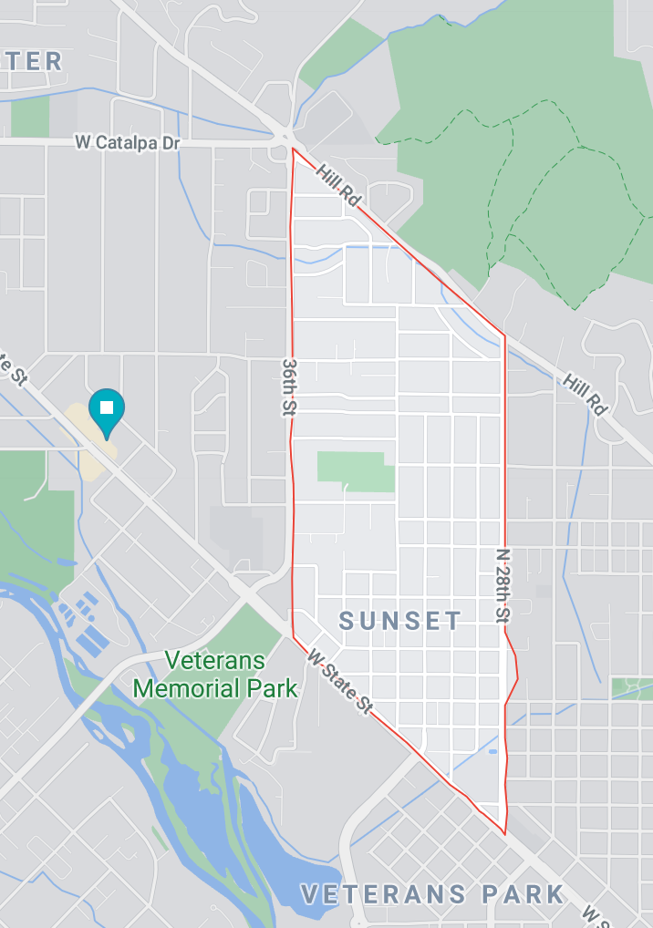
Sunset Neighborhood
Sunset Neighborhood Association:
No vote has been held as opposition to Shelter has been almost non-existent
General Perception is in favor of Shelter as originally proposed
SNA boundary 2,300 ft from proposed site at nearest point
Total population 3,017

Slide 39
QUESTION & ANSWER PERIOD

